Slide 1
DATA MINING PROJECT
Team #9: Zenas Huang, Jingzhi Zhou, Yanlong Wang
Class: ISE 535 – Data MINING
Fall 2020

Slide 2
OBJECTIVE & PLAN
Objective: Our project objective is to analyze the Wisconsin breast cancer morphological dataset set, identify the most important attributes and develop an effective model for diagnosis.
Plan: We use a 70-30 train-test split to compare the efficacy of a Decision Tree, Random Forest, Gradient Boost and Logistic Regression models on different subsets of the data (mean, standard error, “worst”, and mean+”worst” values) to identify the most predictive technique and most informative subsets of attributes.

Slide 3
DATA DESCRIPTION
Data Sources: https://archive.ics.uci.edu/ml/datasets/Breast+Cancer+Wisconsin+%28Diagnostic%29
Data Description: the dataset has no missing values and consists of 569 observations across 32 attributes.
The Mean, Standard Error (SE), and Worst (average of 3 largest) of ten real-valued features are computed for each cell number.

Slide 4
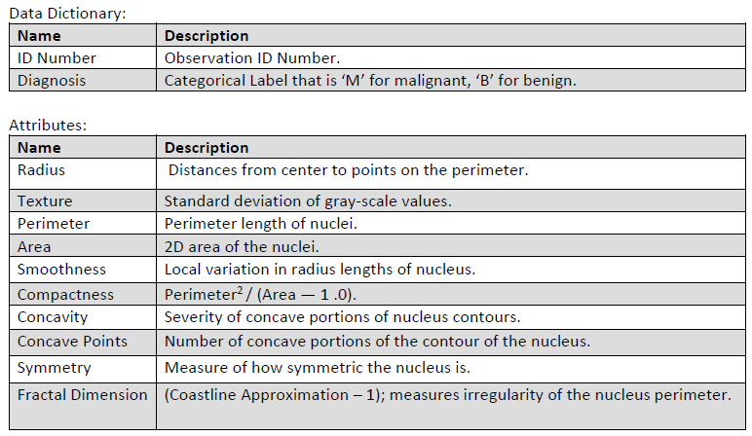
DATA DICTIONARY

Slide 5
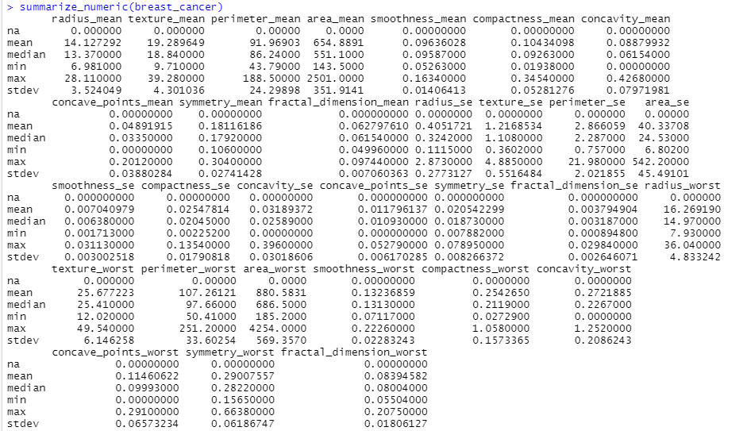
Exploratory Data Analysis Document
Initial Data Review and Cleanup - Numerics

Slide 6
Exploratory Data Analysis Document
Initial Observations
Data appears very clean
No missing or impossible values.
Each instance contains multiple nuclei, these 10 base attributes are reported as Mean, Standard Error (SE), and Worst (average of 3 largest) for a nominal total of 30 attributes for each observation.
Composition
569 Total Observations
30 Numeric attributes

Slide 7
Exploratory Data Analysis Document
Numeric Variables
Mean:
'radius_mean', 'texture_mean', 'perimeter_mean', 'area_mean',
'smoothness_mean', 'compactness_mean', 'concavity_mean','concave_points_mean',
'symmetry_mean', 'fractal_dimension_mean',
Standard error:
'radius_se', 'texture_se', 'perimeter_se', 'area_se', 'smoothness_se', 'compactness_se',
'concavity_se', 'concave_points_se', 'symmetry_se', 'fractal_dimension_se',
Worst:
'radius_worst', 'texture_worst', 'perimeter_worst', 'area_worst', 'smoothness_worst', 'compactness_worst', 'concavity_worst', 'concave_points_worst',
'symmetry_worst', 'fractal_dimension_worst'

Slide 8
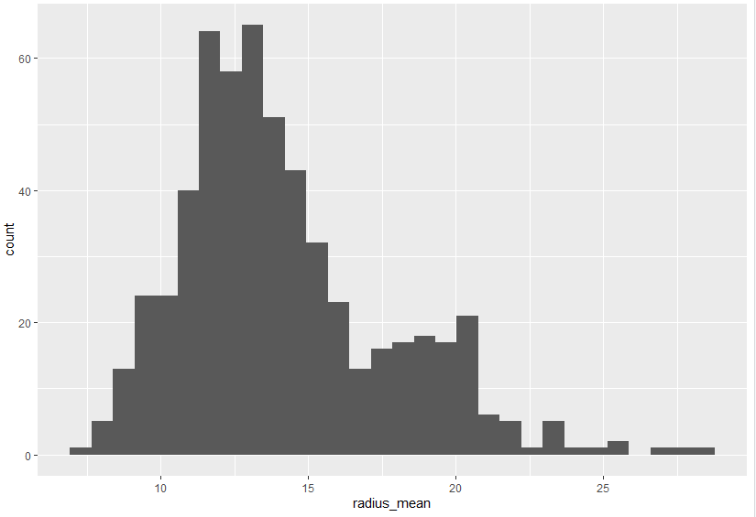
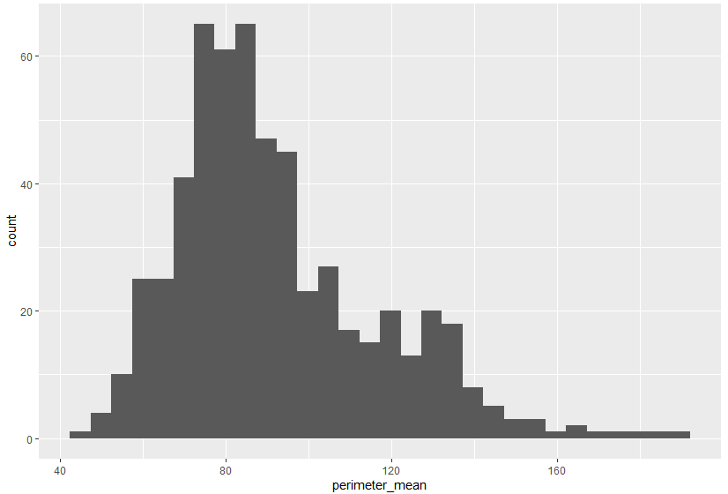
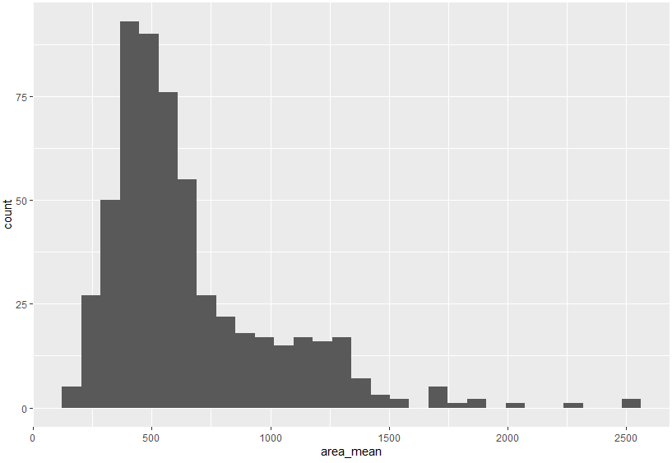
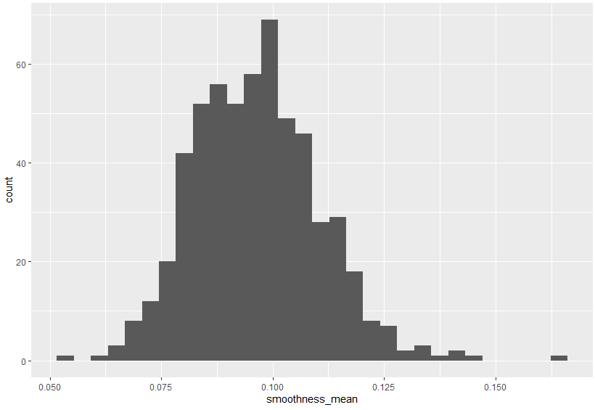
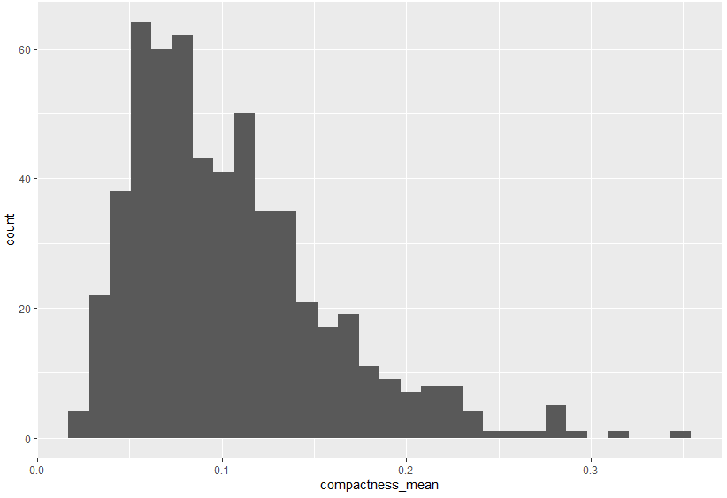
Exploratory Data Analysis Document
Summary of mean

Slide 9
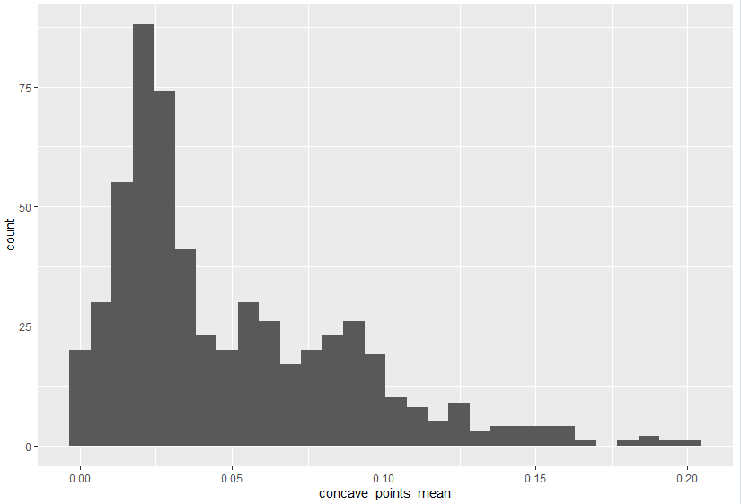
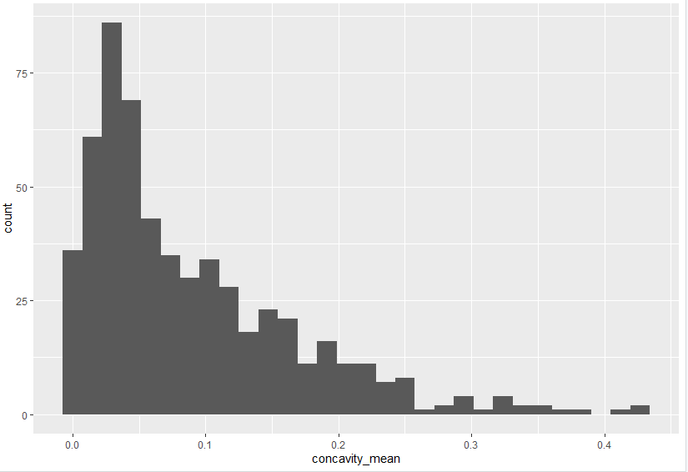
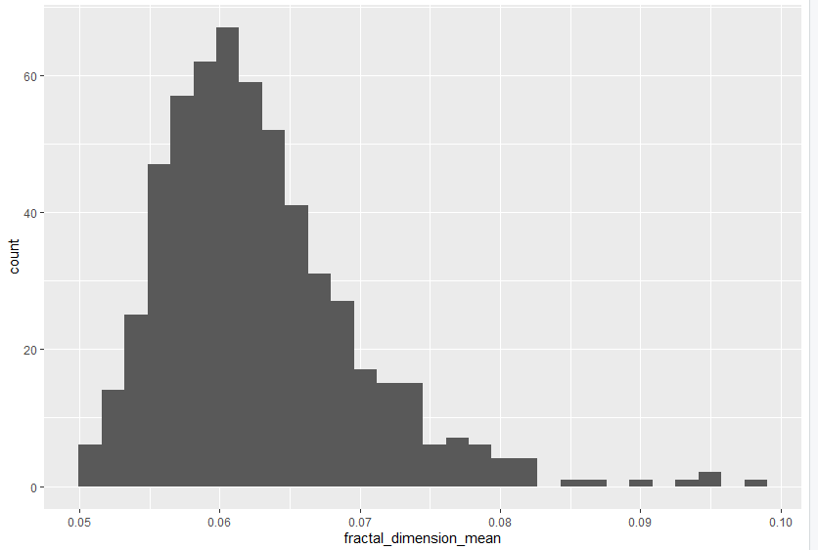
Exploratory Data Analysis Document

Slide 10
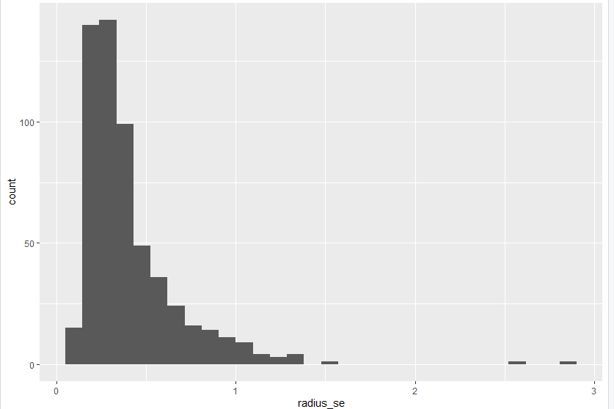
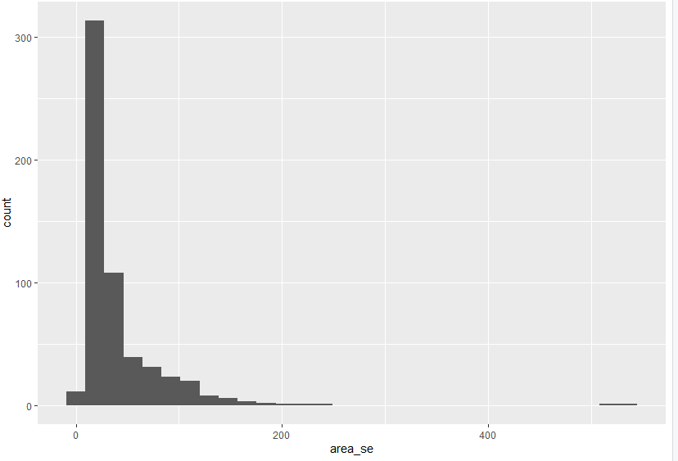
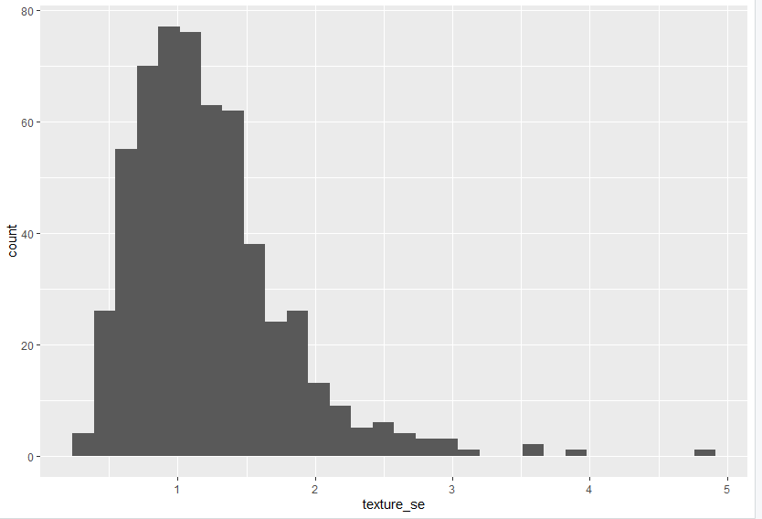
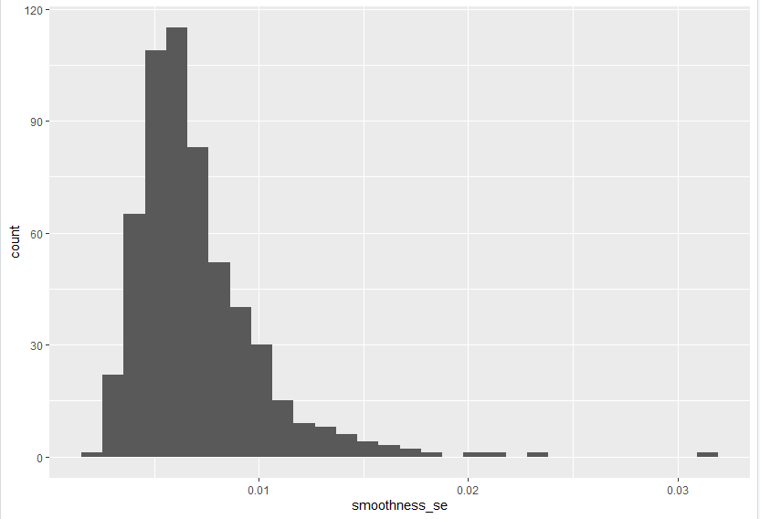
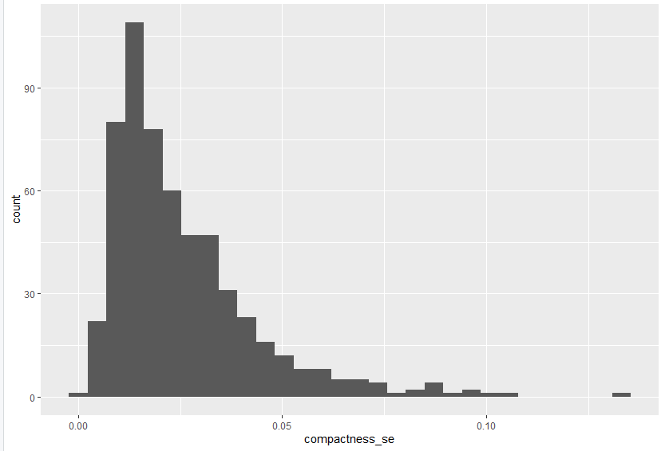
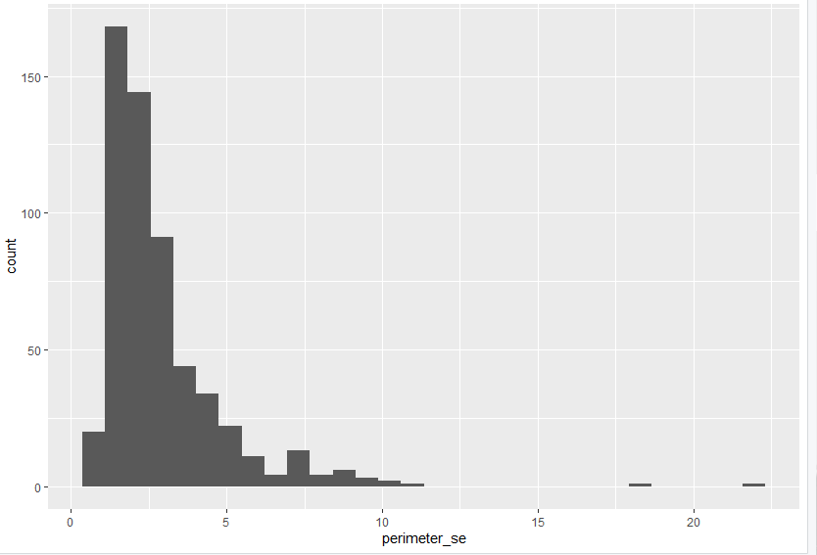
Exploratory Data Analysis Document
Summary of SE

Slide 11
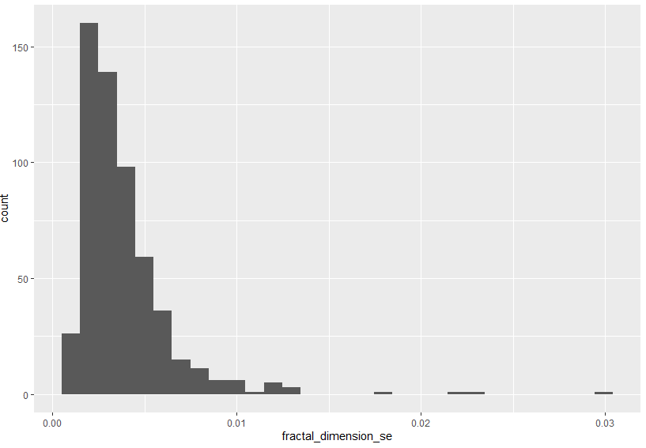
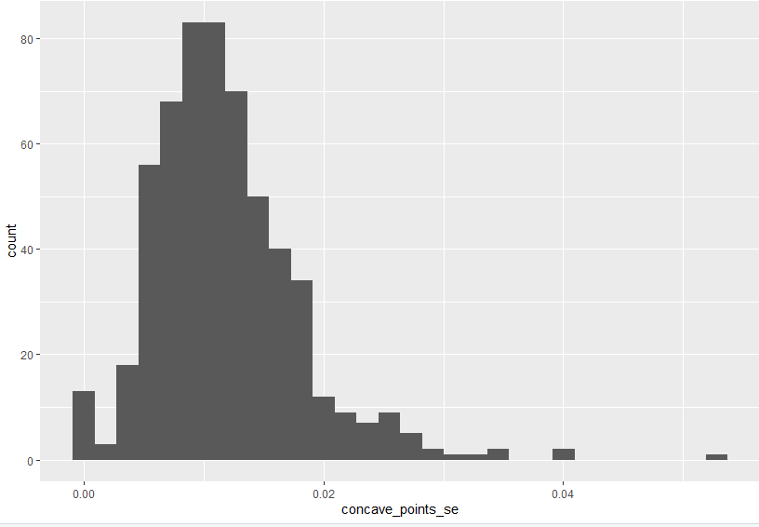
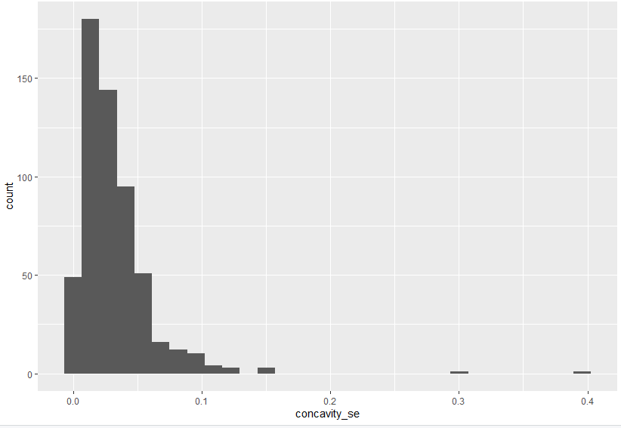
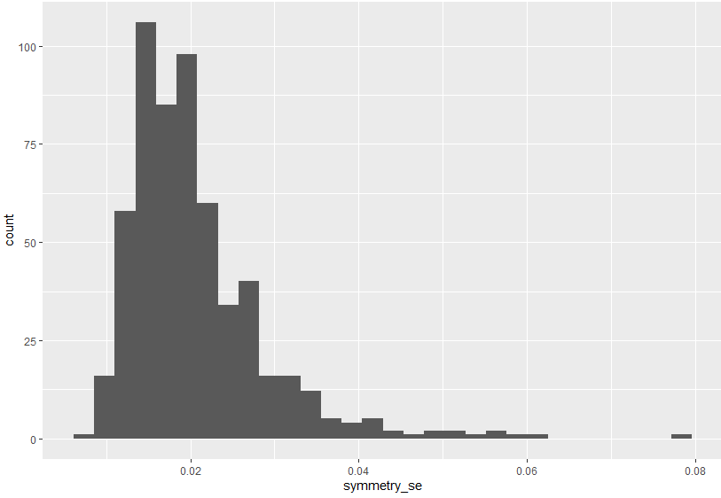
Exploratory Data Analysis Document

Slide 12
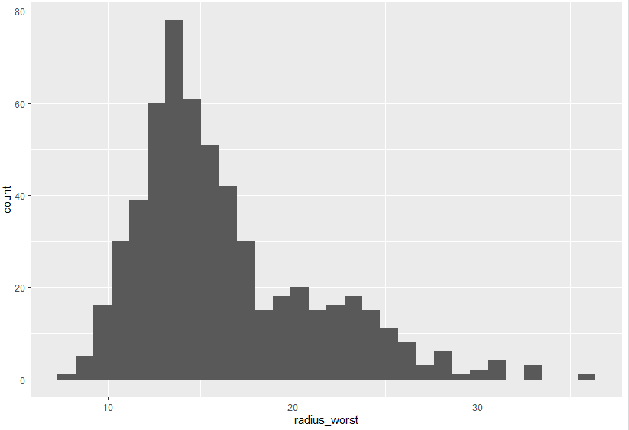
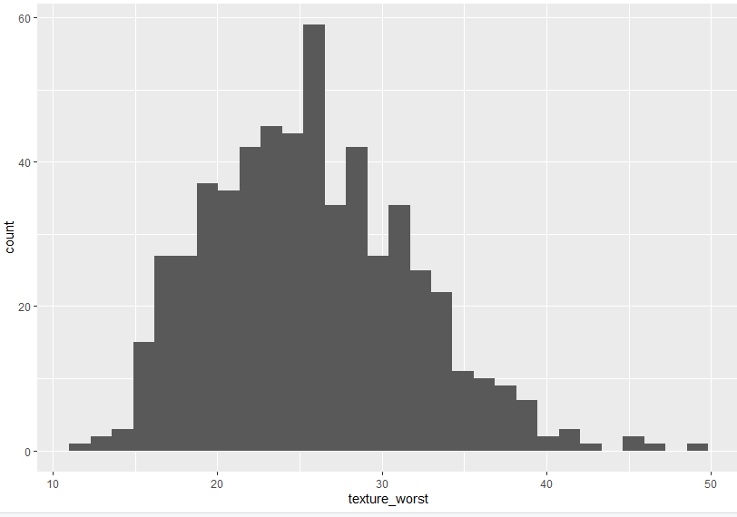
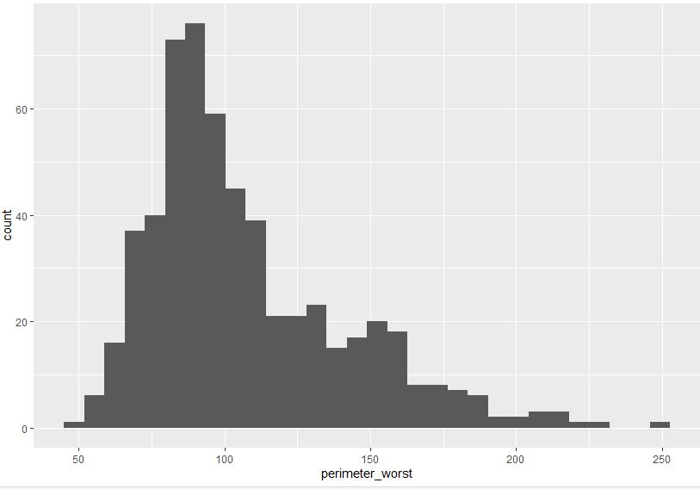
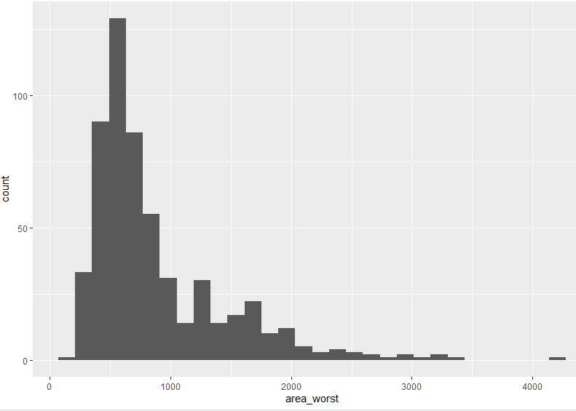
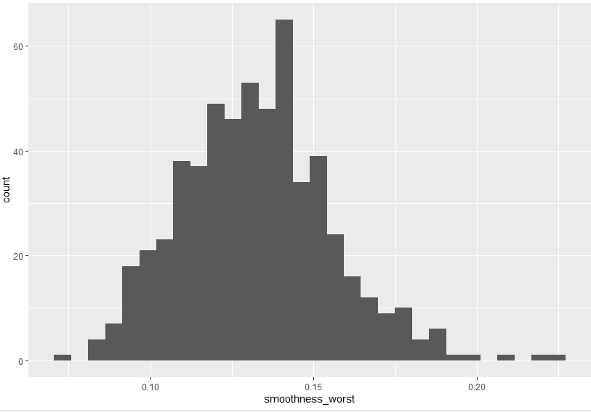
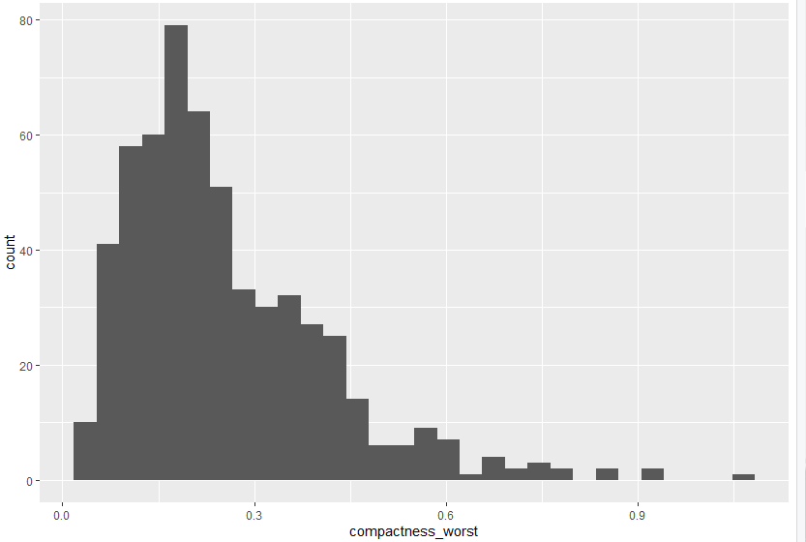
Exploratory Data Analysis Document
Summary of Worst

Slide 13
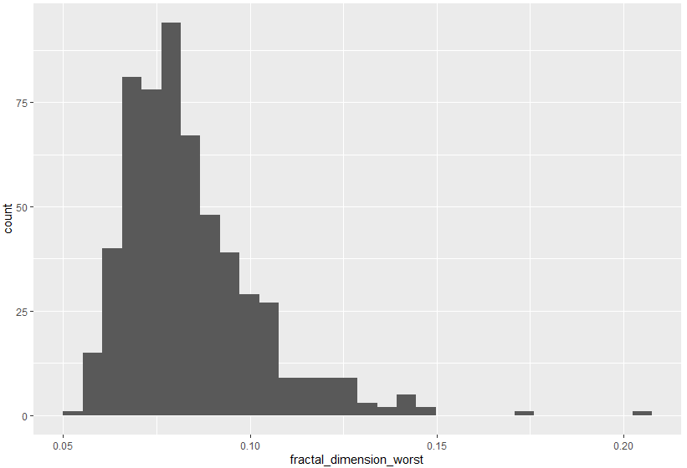
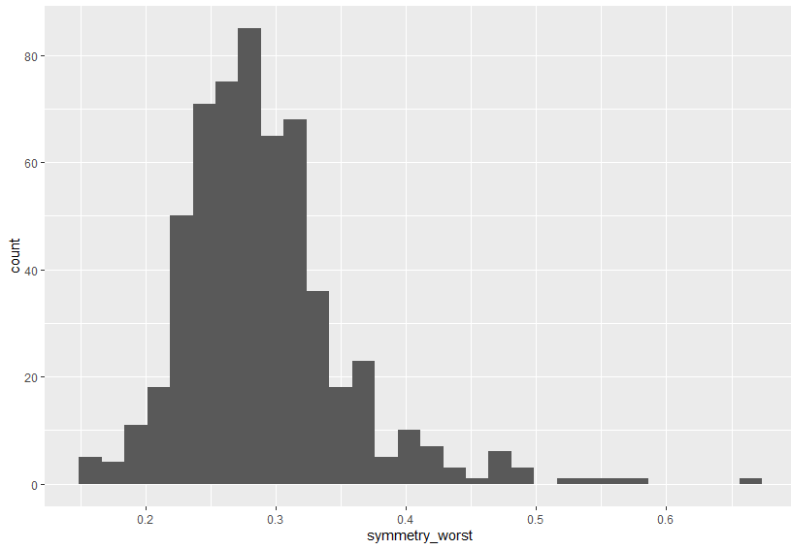
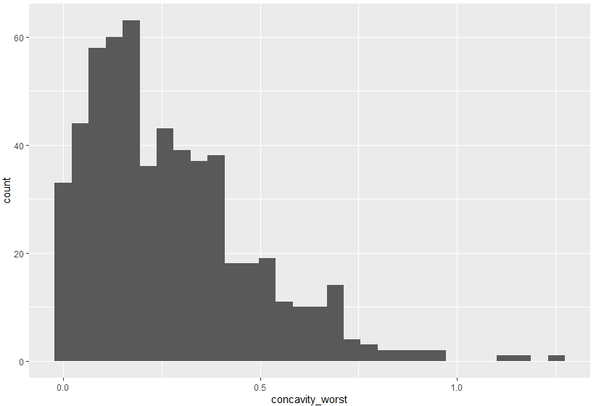
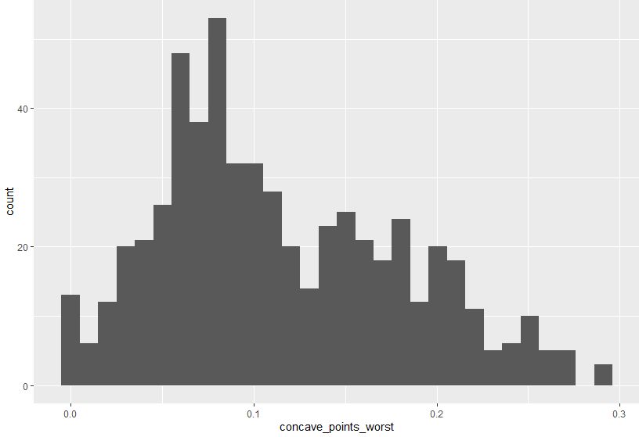
Exploratory Data Analysis Document

Slide 14
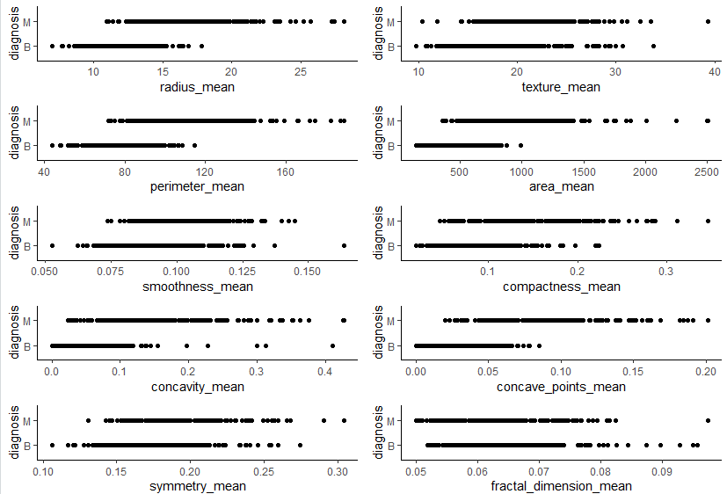
Exploratory Data Analysis Document

Slide 15
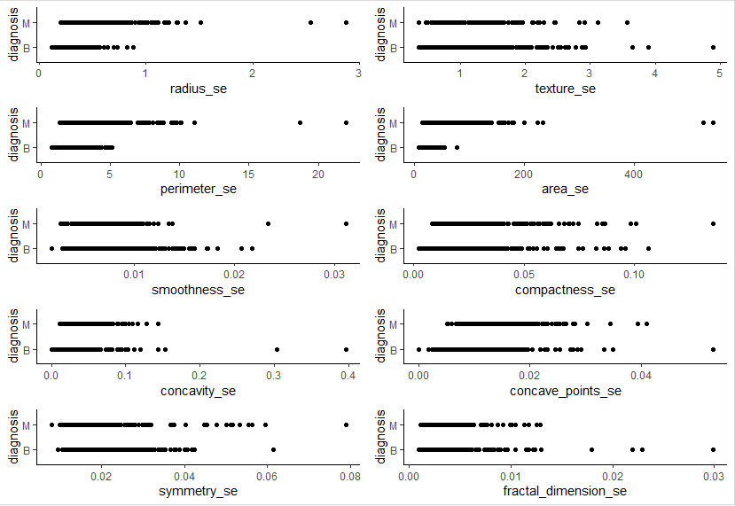
Exploratory Data Analysis Document

Slide 16
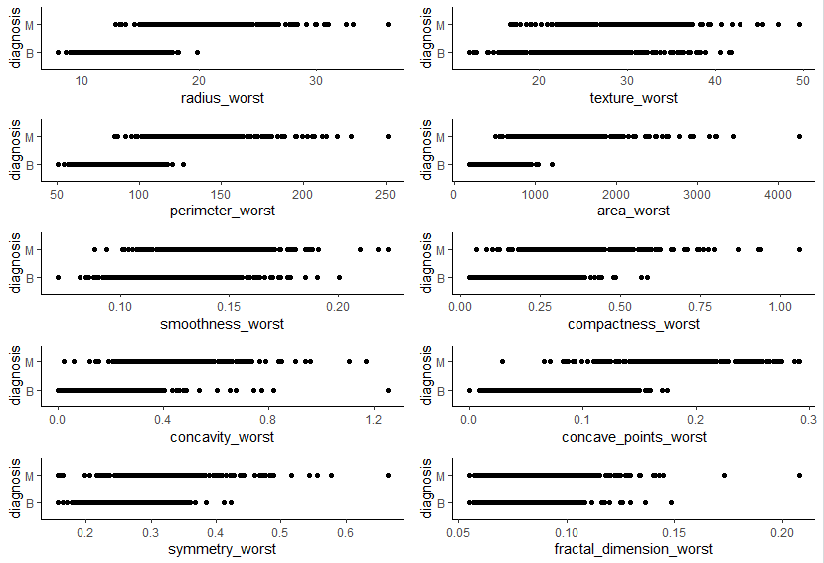
Exploratory Data Analysis Document

Slide 17
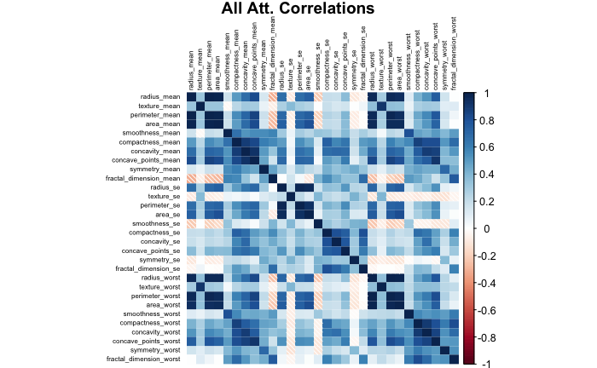
Correlations on All Attributes

Slide 18
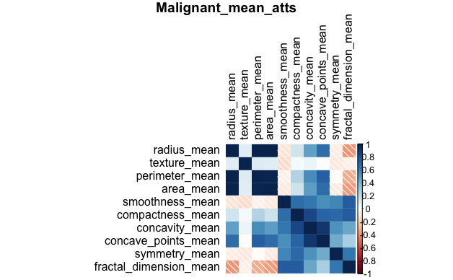
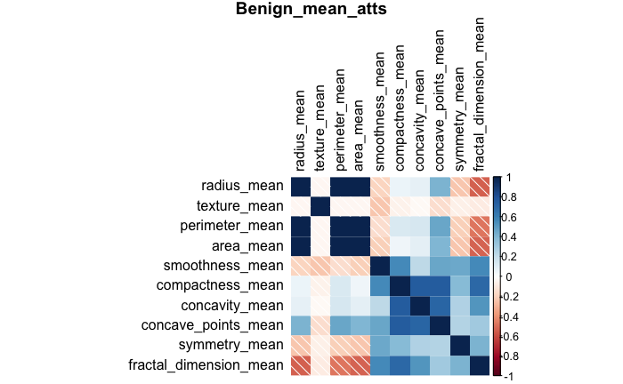
Mean Attribute Correlations

Slide 19
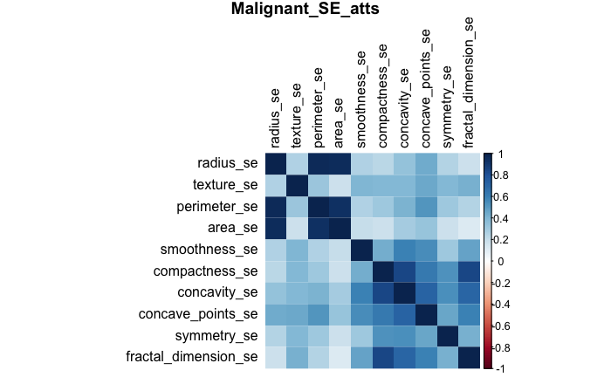
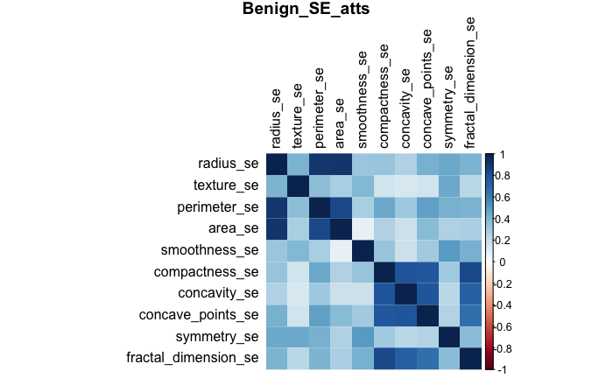
Standard Error Attribute Correlations

Slide 20
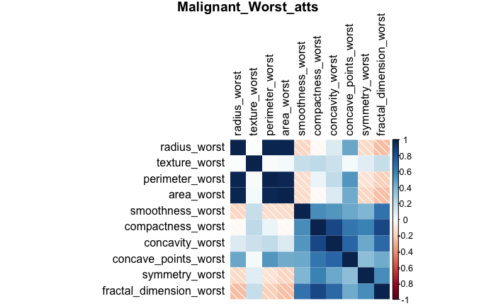
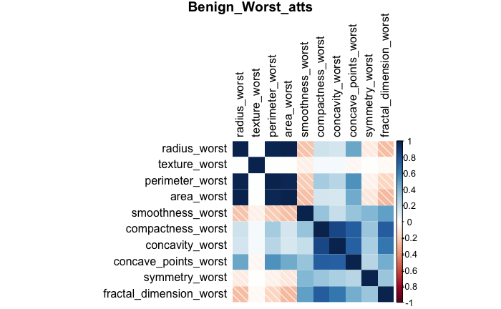
“Worst” Attribute Correlations

Slide 21
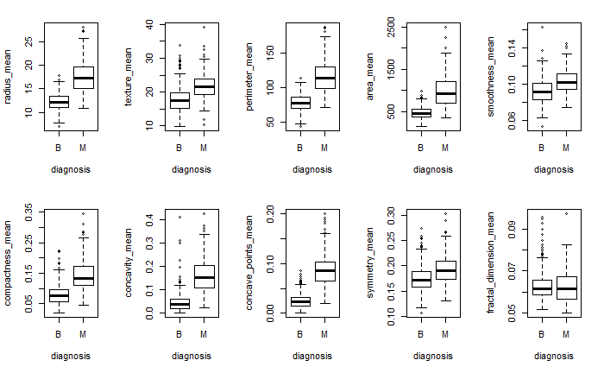
Univariate Attribute Boxplots by Diagnostic Class
Mean Attributes
The means for Malignant diagnosis are overall higher than those for benign diagnosis for all mean attributes.
The intervals for Malignant diagnosis are also wider.

Slide 22
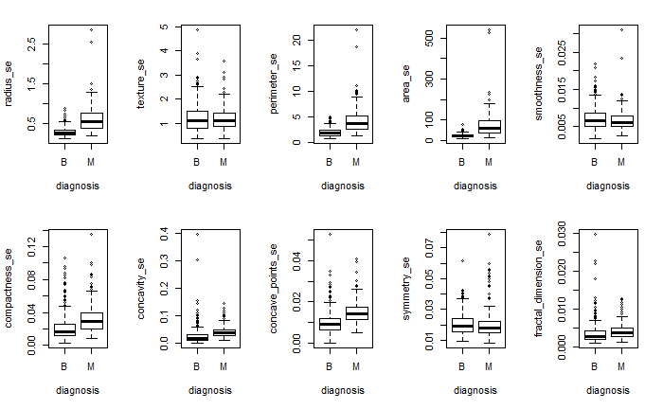
Univariate Attribute Boxplots by Diagnostic Class
Standard Error Attributes
There isn’t significant difference in means and intervals standard errors for Malignant and benign diagnosis for all standard error attributes.

Slide 23
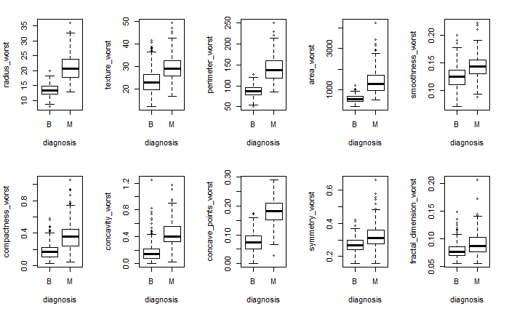
Univariate Attribute Boxplots by Diagnostic Class
Worst Attributes
The means for Malignant diagnosis are overall higher than those for benign diagnosis for all worst attributes.

Slide 24
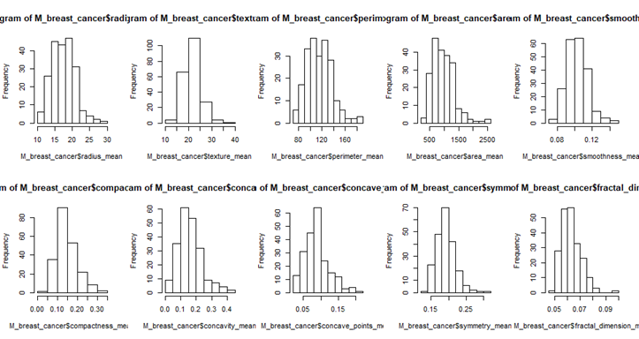
Univariate Histograms by Diagnostic Class - Malignant: Mean

Slide 25
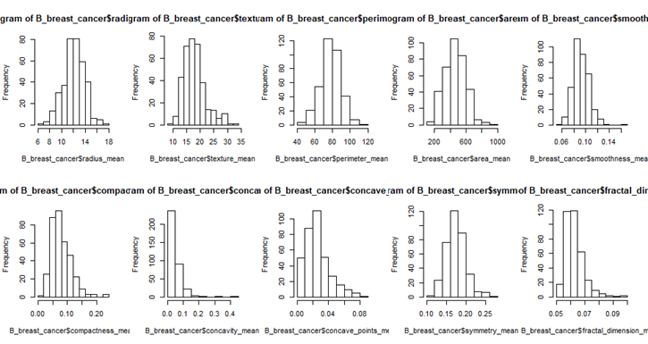
Univariate Histograms by Diagnostic Class - Benign: Mean

Slide 26
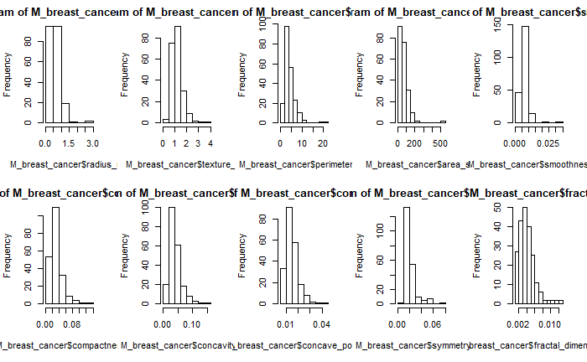
Univariate Histograms by Diagnostic Class - Malignant: SE

Slide 27
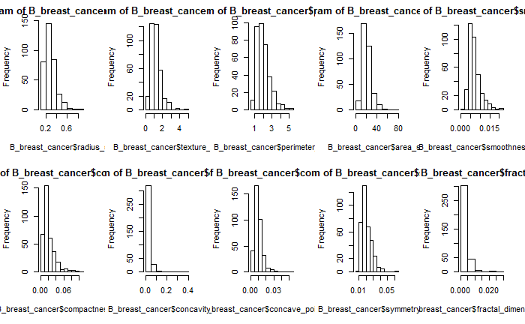
Univariate Histograms by Diagnostic Class - Benign: SE

Slide 28
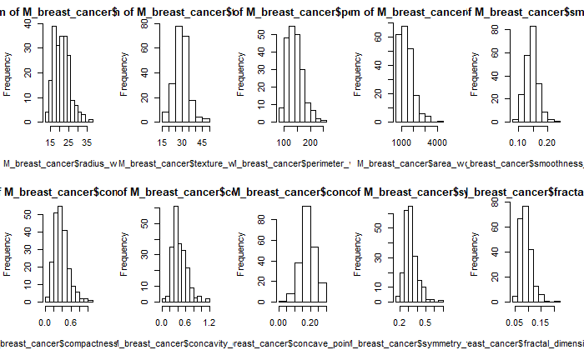
Univariate Histograms by Diagnostic Class - Malignant: Worst

Slide 29
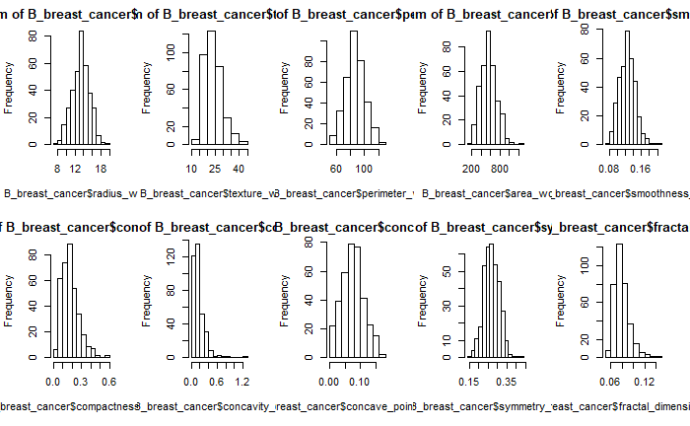
Univariate Histograms by Diagnostic Class - Benign: Worst

Slide 30
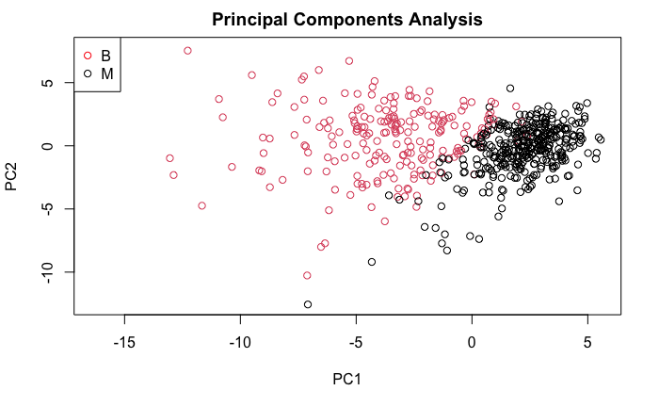
Principal Components Analysis

Slide 31






CLUSTERING
Coloring by Class
Coloring by K-means Cluster, k=2

Slide 32






CLUSTERING

Slide 33






CLUSTERING

Slide 34






CLUSTERING

Slide 35






CLUSTERING

Slide 36



3D - CLUSTERING
3D clustering visualizations for symmetry, smoothness and fractal dimension were performed due to their apparent inseparability in the 2D visualizations. Smoothness is revealed to be separable on a non-standard axis (confirming the result of the k-means clustering).

Slide 37






Bivariate Analysis of Select Correlated Attributes Against Diagnosis

Slide 38






Bivariate Analysis of Select Correlated Attributes Against Diagnosis

Slide 39
EDA DISCUSSION & INSIGHTS
Univariate Analysis
EDA reveals that all variables are well-approximated by Gaussian distribution so standard model normality assumptions are mostly valid.
Outliers
Box & scatter plots show few outliers distributed in each class; none impactful enough to warrant removal.
PCA reveals the dataset is linearly separable and thus amenable to analysis by standard classifier models.
Bi-variate Analysis & Clustering
Symmetry and Fractal Dimension are less easily separated but
K-means clustering analysis reveals that each set of variables otherwise admits of relatively distinct linear decision boundaries and class centroids.
Radius, perimeter and area show strong correlations as expected due to cancer nuclei being circular objects. Concavity & Compactness also show strong correlation.

Slide 40
MODELING RESULTS
(ALL ATTRIBUTES DATA)

Slide 41

Decision Tree Model (All attributes)
Actual\Predicted | Benign | Malignant
Benign | 60% | 2.94%
Malignant | 4.12% | 32.94%
Test Accuracy: 92.94%
Decision Tree Hyperparameters:
Minsplit = 40, minbucket=3, maxdepth=5, complexity=-1
The most important features in the Decision Tree Model run on all attributes were: Perimeter_worst, concave_points_worst, concave_points_mean.

Slide 42

Random Forest Model (All attributes)
Actual\Predicted | Benign | Malignant
Benign | 61.18% | 1.76%
Malignant | 2.35% | 34.71%
Test Accuracy was 95.88%
Random Forest Hyperparameters:
mtry = 5, ntree = 300, nodesize=1
The most informative features for splitting are perimeter, concave_points, and smoothness.

Slide 43

Gradient Boost Model (All Attributes)
Actual\Predicted | Benign | Malignant
Benign | 62.36% | 0.01%
Malignant | 0.03% | 34.11%
Test Accuracy was 96.47%
Gradient Boost Hyper Parameters:
200 trees, multinomial distribution, shrinkage = 0.01, 10 cross-validation folds
The top 5 most important features in the Gradient Boost Model run on all attributes were: Perimeter_worst, concave_points_worst, concave_points_mean, area_worst, radius_worst.

Slide 44
Multiple Logistic Regression
Stepwise algorithm with a “both” selection approach on Chi-Squared test criteria is used for choosing predictors for all MLR models.
All 30 Attributes Best Model:
formula:
isM ~ smoothness_worst + texture_worst + symmetry_worst +
compactness_se + concavity_mean + texture_se + area_se +
concave_points_worst + area_worst
where isM = 1 denotes the diagnosis is malignant and isM = 0 indicates the diagnosis is benign.
Model AIC: 73.097; Test accuracy: 97.07602%

Slide 45
MODELING RESULTS
(MEAN ATTRIBUTES DATA)

Slide 46

Decision Tree Model (mean attributes only)
Actual\Predicted | Benign | Malignant
Benign | 58.82% | 4.12%
Malignant | 5.29% | 31.76%
Test accuracy was 90.59%
The most informative features for splitting are concave points, radius, and texture.

Slide 47

Random Forest Model (mean attributes only)
Actual\Predicted | Benign | Malignant
Benign | 59.41% | 3.53%
Malignant | 4.12% | 32.94%
Test Accuracy is 92.35%
The top 5 more important features for the Random Forest model run on the Mean features are: Concave_points,, Perimeter, Radius, Concavity, and Area.

Slide 48

Gradient Boost Model (mean attributes only)
Actual\Predicted | Benign | Malignant
Benign | 60% | 2.94%
Malignant | 4.12% | 32.94%
Test Accuracy is 92.94%
The top 5 more important features for the Gradient Boosting model run on the Mean features are: concave_points, Area, concavity, perimeter, and Radius.

Slide 49
Multiple Logistic Regression
Mean Attributes Only Best model:
formula:
isM ~ concave_points_mean + texture_mean + area_mean +
perimeter_mean + smoothness_mean + symmetry_mean,
where isM = 1 denotes the diagnosis is malignant and isM = 0 indicates the diagnosis is benign.
Model AIC: 162.06; Test accuracy: 95.32164%

Slide 50
MODELING RESULTS
(STANDARD ERROR ATTRIBUTES DATA)

Slide 51

Decision Tree Model (Standard Error Attributes Only)
Actual\Predicted | Benign | Malignant
Benign | 54.71% | 8.24%
Malignant | 7.65% | 29.41%
Test accuracy was 84.12%
The most informative features for splitting are area, concavity, and texture.

Slide 52

Random Forest Model (Standard Error Attributes Only)
Actual\Predicted | Benign | Malignant
Benign | 55.88% | 7.06%
Malignant | 8.82% | 28.24%
Test Accuracy is 84.12%
The top 5 more important features for the Random Forest model run on the Standard Error features are: Area, Perimeter, Radius, Concavity, and Concave Points.

Slide 53

Gradient Boosting Model (Standard Error Attributes Only)
Actual\Predicted | Benign | Malignant
Benign | 59.41% | 3.53%
Malignant | 8.82% | 28.24%
Test Accuracy is 87.65%
The top 5 more important features for the Gradient Boosting model run on the Standard Error features are: Area, Concavity, Symmetry, Texture, and Smoothness.

Slide 54
Multiple Logistic Regression
Standard Error Attributes Only Best Model:
formula:
isM ~ area_se + radius_se + compactness_se + fractal_dimension_se,
where isM = 1 denotes the diagnosis is malignant and isM = 0 indicates the diagnosis is benign.
Model AIC: 277.34; Test accuracy: 90.05848%

Slide 55
MODELING RESULTS
(“WORST” ATTRIBUTES DATA)

Slide 56

Decision Tree Model (“Worst” Attributes Only)
Actual\Predicted | Benign | Malignant
Benign | 61.18% | 1.76%
Malignant | 4.71% | 32.35%
Test accuracy was 93.53%
The most informative features for splitting are perimeter, concave_points, and smoothness.

Slide 57

Random Forest Model (“Worst” Attributes Only)
Actual\Predicted | Benign | Malignant
Benign | 60.59% | 2.35%
Malignant | 2.94% | 34.12%
Test Accuracy is 94.71%
The top 5 features for the Random Forest Model run on only the “Worst” attributes are Perimeter, Concave_Points, Radius, Area, and Concavity.

Slide 58

Gradient Boosting Model (“Worst” Attributes Only)
Actual\Predicted | Benign | Malignant
Benign | 60.59% | 2.36%
Malignant | 2.94% | 34.12%
Test Accuracy is 94.71%
The top 5 features for the Gradient Boosting Model run on only the “Worst” attributes are Concave_Points, Perimeter, Area, Radius. and Concavity.

Slide 59
Multiple Logistic Regression
“Worst” Attributes Only Best model:
formula:
isM ~ smoothness_worst + texture_worst +
concave_points_worst + area_worst,
where isM = 1 represents the diagnosis is malignant; isM = 0 represents the diagnosis is benign.
Model AIC: 99.898; Test accuracy: 98.83041%

Slide 60
MODELING RESULTS
(MEAN & “WORST” ATTRIBUTES DATA ONLY)

Slide 61

Decision Tree Model (Mean+”Worst” Attributes Only)
Actual\Predicted | Benign | Malignant
Benign | 58.82% | 4.12%
Malignant | 3.53% | 33.53%
Test accuracy was 92.35%
The most informative features for splitting are perimeter worst, concave points worst, and texture worst.

Slide 62

Random Forest Model (Mean+”Worst” Attributes Only)
Actual\Predicted | Benign | Malignant
Benign | 61.18% | 1.76%
Malignant | 2.94% | 34.12%
Test Accuracy is 95.29%
The top 5 important features are concave_points_worst, radius worst, perimeter_worst, area_worst and concave_points_mean.

Slide 63

Gradient Boosting Model (Mean+”Worst” Attributes Only)
Actual\Predicted | Benign | Malignant
Benign | 60.76% | 1.18%
Malignant | 4.12% | 33.94%
Test Accuracy is 94.71%
The top 5 important features are perimeter_worst, concave_points_worst, concave_points_mean, area_worst, and radius_worst.

Slide 64
Multiple Logistic Regression
Worst & Mean attributes Best model:
Since the SE attributes model has the lowest test accuracy, we exclude the ten SE attributes and perform another logistic regression on Mean & Worst attributes only.
formula:
isM ~ smoothness_worst + texture_worst + concave_points_mean +
area_worst + perimeter_mean + symmetry_worst + compactness_mean,
where isM = 1 denotes the diagnosis is malignant and isM = 0 indicates the diagnosis is benign.
Model AIC: 90.063; Test accuracy: 99.4152%
The best logistic regression model.

Slide 65
Model Performance Summary
Test Accuracy per Model | All Attributes | Mean Atts. | Std Err. Atts. | Worst Atts. | Mean & Worst Atts.
Decision Tree | 92.94% | 90.59% | 84.12% | 93.53% | 92.35%
Random Forest | 95.88% | 92.35% | 84.12% | 94.71% | 95.29%
Gradient Boost | 96.47% | 92.94% | 87.65% | 94.71% | 94.71%
Logistic Regression | 97.08% | 95.32% | 90.06% | 98.83% | 99.42%

Slide 66
FINAL RESULTS & INSIGHTS
Excluding the standard error subset of attributes for all parameters improves the performance of our classifiers in all cases.
From the Mean-Worst Decision Tree, we find that the combination of “perimeter_worst”<106, “concave_points_worst”<0.13, “symmetry_worst”>=0.2 and “texture_worst”<33 characterizes most benign diagnoses.
Similarly, the combination of “perimeter_worst”>106, “concave_points_mean”>0.05, and “texture_worst”>20 characterizes most malignant diagnoses.

Slide 67
FINAL RESULTS & INSIGHTS CONT.
4. The most significant features presented by decision tree, random forest
and gradient boosting are all confirmed by multiple logistic regression
model.
5. The attribute threshold values uncovered by the Decision Trees roughly
correspond to midpoint values between the centroids found by the clustering analysis in our EDA.
6. Comparing model results, the shape attributes such as perimeter,
concave points, area and radius are ranked highest according to the random forest and gradient boosting feature importance rankings, while texture-based attributes such as texture, symmetry and smoothness are ranked lower. However, the test performance gain in the logistic regressions from including these texture-based attributes demonstrates that they are still of high predictive value.

Slide 68
FINAL RECOMMENDATIONS & NEXT STEPS
The results of this Project revealed that nuclei shape attributes (e.g. radius, perimeter,concavity) were of primary importance for diagnostic classification of cancer malignancy/benignity and that texture attributes (e.g. smoothness, symmetry) were of secondary importance but nevertheless informative for predictive purposes.
Future work should explore a two-tiered analysis in which observations are first clustered and pre-binned based on shape features with subsequent classifiers trained on texture-based features in order to discern decision thresholds for texture-based features among nuclei of similar shapes.
Additional models such as the perceptron/pocket algorithm, multilayer perceptron, linear discriminant analysis and support vector machines may uncover additional insights and should be compared to the existing models used in our analysis.

